Slide 1


Slide 2
Walmart Project: Use market basket analysis to classify shopping trips Team: Aishwarya Kadam, Shrey Gupta, Tapan Golakiya

Slide 3
CONTENTS
2.
3.
1.
Overview
Data Description
Data visualization
5.
6.
4.
Classification techniques
Results
Data Pre-processing

Slide 4
Overview Walmart uses data to classify the type of trip the customer has made. This helps them in improving the customer shopping experience. The trip types can range from a weekly shopping trip to buying puppy supplies. There are 38 such categories (unlabelled) of trips. The data set used for this problem has been taken from the Kaggle competition: https://www.kaggle.com/c/walmart-recruiting-trip-type-classification Goal The project aims at classifying the type of trips made by the consumer based on the products that s/he purchases and other trip parameters.

Slide 5
Attributes: 6 Target: “TripType” TripType - A categorical id representing the type of shopping trip the customer made. VisitNumber - An id corresponding to a single trip by a single customer. Weekday - The day of the week of the trip. Upc - The UPC number of the product purchased. This is a unique ID of the product. ScanCount - The number of the given item that was purchased. A negative value indicates a product return. DepartmentDescription - A high-level description of the item's department FinelineNumber - A more refined category for each of the products, created by Walmart Train Data (shape): 647054 x 7 Test Data (shape): 653646 x 6
Dataset Description

Slide 6
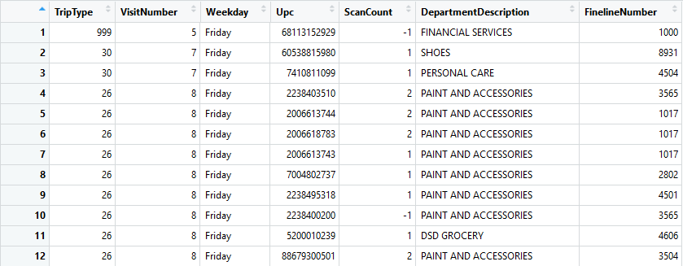
Dataset

Slide 7
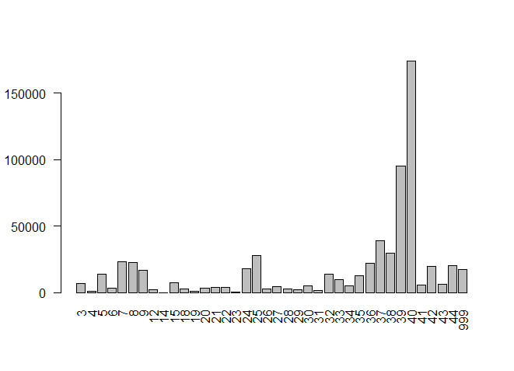
Target Class: TripType
Dataset visualization using histogram
OBSERVATIONS:
We can see from the chart that, Trip type class 40 has the highest frequency/counts.

Slide 8
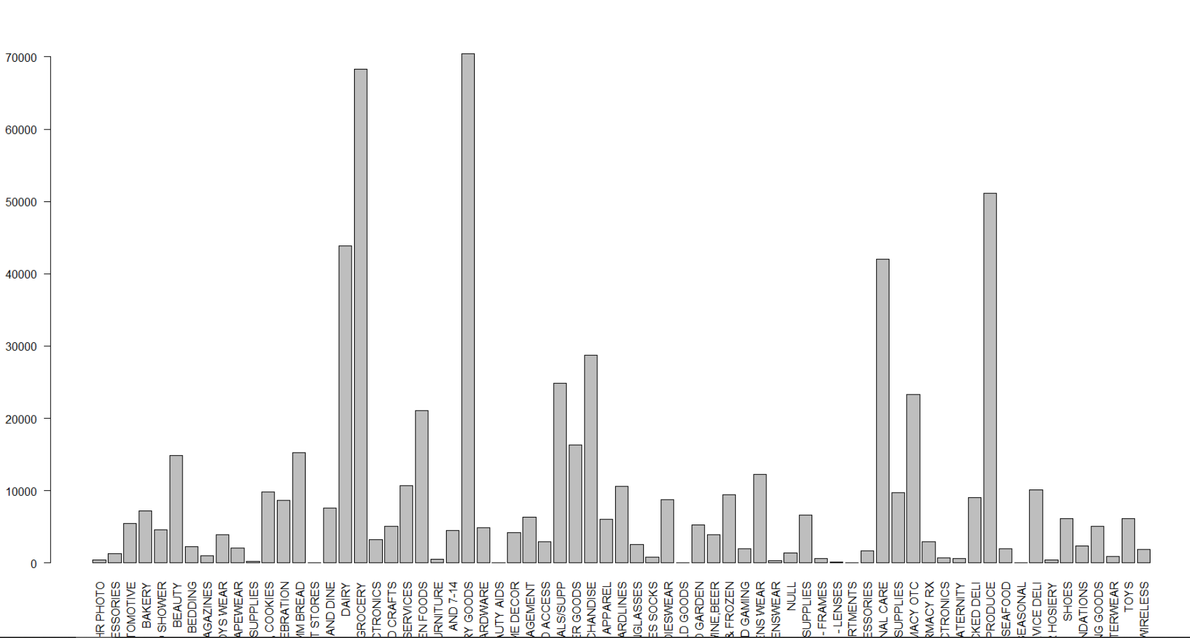
Feature: DepartmentDescription
OBSERVATIONS:
This bar chart shows that, which department has what frequency/count among all departments.
We observed that, "GROCERY" and "GROCERY AND DRY GOODS" have the highest frequency counts.

Slide 9
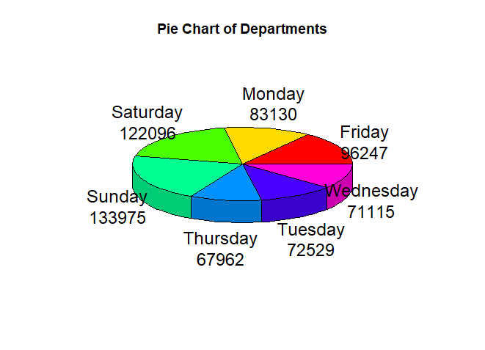
Feature: Weekday
OBSERVATIONS:
This chart shows the frequency/count of transactions made on each day of week.
We observed that, most transactions are made on Saturday and Sunday.

Slide 10
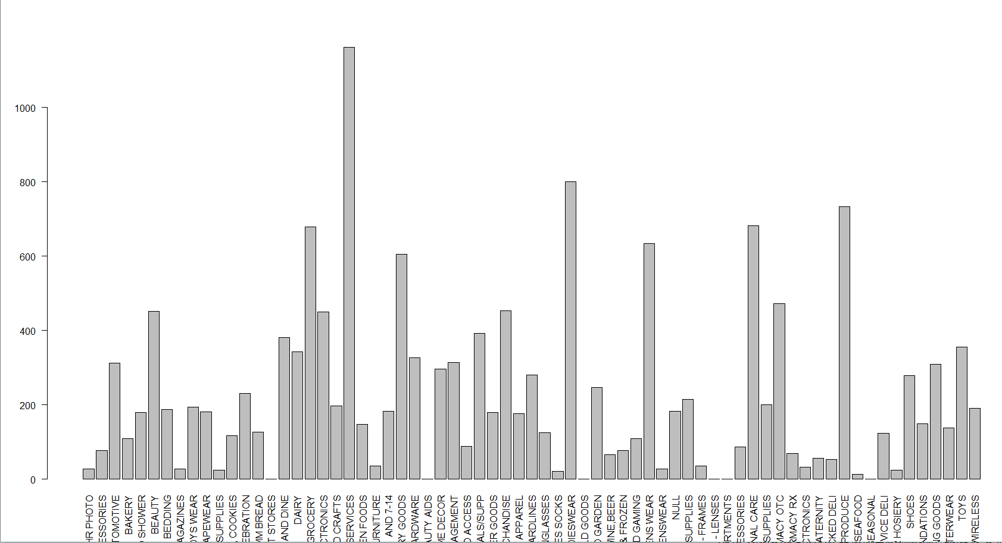
Feature: Departments Vs Return count
OBSERVATIONS:
This chart shows the frequency/count of returned items of each department.
We observed that, products from the department "FINANCIAL SERVICES" are seems to be returned most to store by customers.

Slide 11
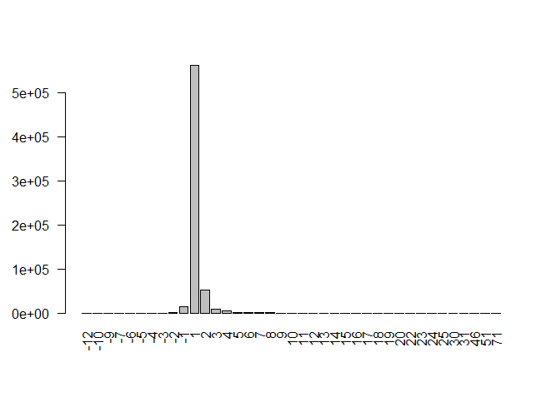
Feature: ScanCount
OBSERVATIONS:
The chart shows the frequency/count of ScanCount feature. This means the number of times an item has been scanned.
We observed that, most of the products sold, have a scan count of 1.

Slide 12
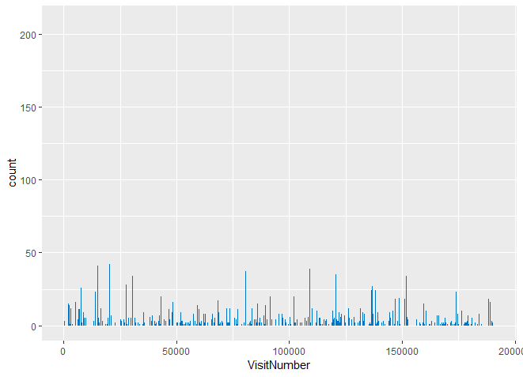
Feature: VisitNumber
OBSERVATIONS:
This chart shows the frequency/count of items in each transaction (VisitNumber).

Slide 13
We removed all the samples having NA values for the “TripType” feature in the dataset since the number of samples with unfilled values were equivalent to the number of NA values for the “TripType” feature. Number of NA samples removed from Train Data: 4129 Train Data (shape): 642925 x 7 DATA SPLITTING (Train Data) Due to the unlabelled Test dataset, we divided the Train dataset for model validation. Train data set was divided in 80:20 ratio by randomly selecting the samples from the dataset. New Dataset shape: Train Data (shape): 514341 x 7 Test Data (shape): 128584 x 7
Dataset Pre-Processing

Slide 14
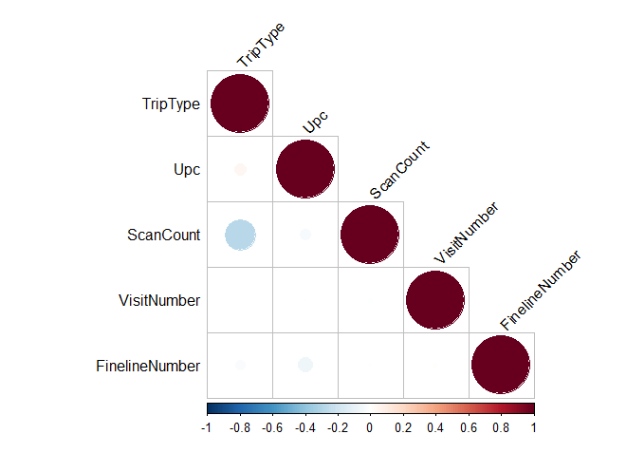
FEATURE SELECTION
OBSERVATIONS:
Correlation Filter
This figure shows the correlation between features of our dataset.
We observed that, there is not much correlation between features of our dataset.

Slide 15
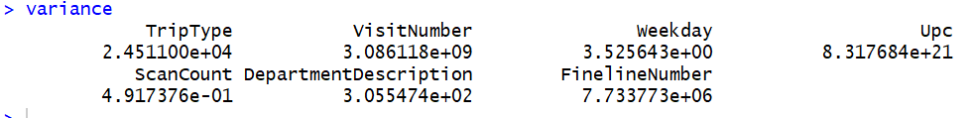
FEATURE SELECTION
OBSERVATIONS
Variance Filter:
We applied the variance filter to remove the feature with the least variance. We observed ScanCount feature to have the least variance and thus removed it.

Slide 16
APRIORI ALGORITHM
The Aprioiri algorithm is used for extracting the rules from the dataset which represents the items bought together.
Rules represent the items that are bought together
Support: 0.0006
Confidence: 0.5
Support: This gives the frequency (no. of times the item occurred) of the item in the dataset.
Confidence: This explains how likely Y is purchased when X is purchased. This defines association between two items.

Slide 17
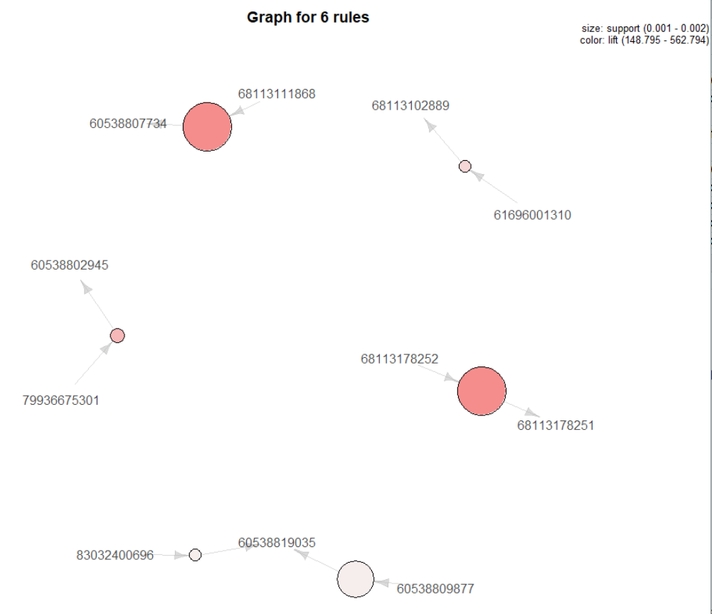
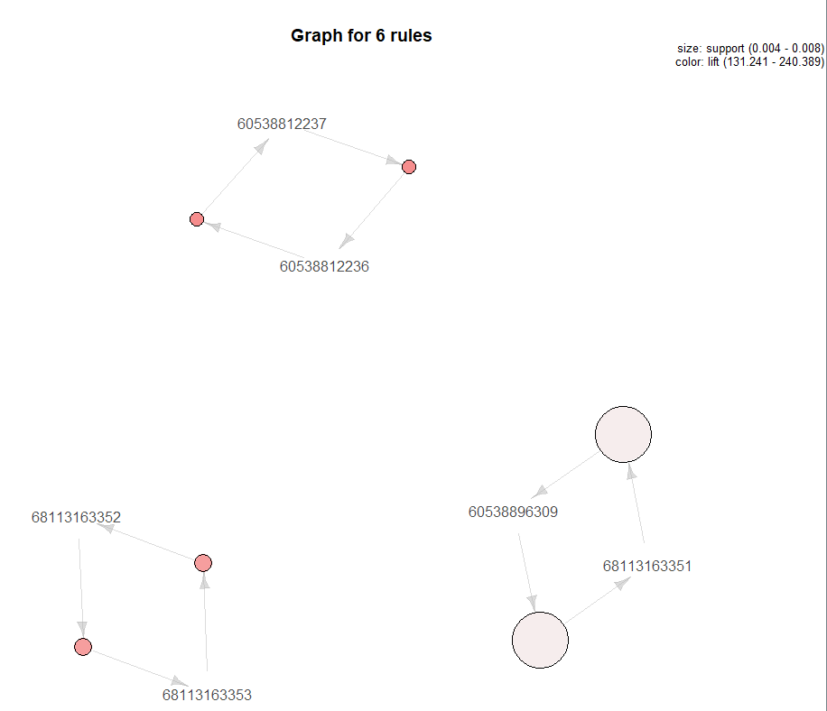
Rule Mapping: (confidence and support)

Slide 18
NAÏVE BAYES CLASSIFIER
Dataset Classification Models
We applied the Naïve Bayes classifier to the revised train and test data set.
Accuracy: 32.96%
Log-loss: 5.013
We observe the accuracy to be low (<50%) and hence, this classifier acts as a baseline for other models.

Slide 19
XGBOOST
We applied the gradient boosting algorithm XgBoost to classify the trip types. XGBoost, short for (extreme) gradient boosting, is a fast, portable, and distributed implementation of the gradient boosting (trees) algorithm.
Gradient boosting: It is an ensemble (i.e. meta) machine learning algorithm that builds a strong model based on many weaker ones sequentially.
Fast: The library is written in C++ and offers many useful wrappers in higher-level languages (Python and R for instance).
Portable and Distributed: Portable means that it can be easily used in different settings/architectures. Distributed means that it can run on multiple cores (single machine) and/or on multiple servers (in a cluster).

Slide 20
Accuracy of prediction: 57.62% Log-loss (300th iteration): 1.379 Parameters for the XgBoost:
max_depth = 12, nthread = 8 nrounds = 500, num_class = 38
eta = 0.1, early_stopping_rounds = 10
min_child_weight = 3

Slide 21
Result Comparison
There is no data/papers provided for the Kaggle competition regarding the model used and its accuracy achieved.
However, certain online blogs performed the data analysis and classification. The highest accuracy achieved for this dataset was 69.7% using one-hot encoding technique and XgBoost classification.

Slide 22
Future Goals Modelling using classifiers: Random Forest, SVM, etc. API to detect Upc numbers.

Slide 23
THANK YOU

